Slide 1
Own Your Own Career
Advice from a Veteran Consultant
David Giard
Microsoft Senior Software Engineer
Former
Consultant

Slide 2
Own Your Own Career
or
Mistakes I’ve made in My Career
and How You Can Learn From My Mistakes
and Avoid Making those Same Mistakes
David Giard
Microsoft Senior Software Engineer

Slide 3
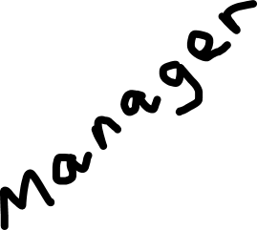
Part 1: Manage Your Customer Part 2: Manage Your Career

Slide 4
Manage Your Customer

Slide 5
Listen to your customer

Slide 6
First impressions are important!

Slide 7
Never lie

Slide 8
Think about privacy

Slide 9
Delight your customer!

Slide 10
Learn Effective Communication

Slide 11
Be professional
Notes:
Know the dress code
Be punctual
Stay focused during work hours

Slide 12
Communicate early. Communicate often.

Slide 13
Stay Positive
Notes:
Every project has good and bad.
Don’t bring down your co-workers.
Deliver good news first.

Slide 14
Learn to accept criticism

Slide 15
Learn to accept praise

Slide 16
Look for opportunities

Slide 17
Know the strengths of your company

Slide 18
Focus on teamwork
Notes:
Keep a positive attitude.
No badmouthing.
Mentor junior devs.
Know when to compromise

Slide 19
Learn names

Slide 20
Bring passion to each project

Slide 21
Listen to your customer

Slide 22
Manage Your Career

Slide 23
Set Measurable Goals

Slide 24
Track your accomplishments

Slide 25
Find a mentor. Talk with him or her regularly.

Slide 26
Know the people in your unit

Slide 27
Learn the basics of software development
Cultivate a specialty

Slide 28
Understand and manage your online identity

Slide 29
Your education is not limited to your day job
Notes:
Books
Podcasts
Magazines
Blogs
Conferences

Slide 30
Learn something new every day
Notes:
Books
Podcasts
Magazines
Blogs
Conferences

Slide 31
Accomplish something every day
Notes:
Books
Podcasts
Magazines
Blogs
Conferences

Slide 32
Consider certification

Slide 33
Get involved in the local community

Slide 34
Cool story, bro.
But what’s the point?

Slide 35
It sounds obvious. It’s not.
Own your own career.

Slide 36
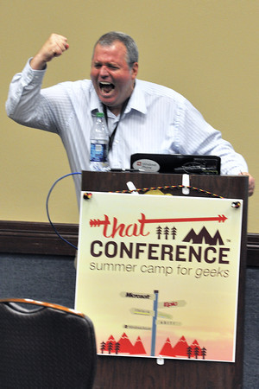
David Giard Microsoft Senior Software Engineer davidgiard.com technologyandfriends.com @davidgiard

